Slide 1


Capstone Project
Presented By :- Group 1
Chaitrali Adhav
Avinash Dangat
Ashutosh Jagtap
Anurag Gadge
Anand Prakash Yadav
Abhishek Katyayan

Slide 2
Index
Index
Introduction to Project
Tools and Techniques
Data Understanding
Data Preparation and Feature Engineering
Data Cleaning
Feature Selection
Model Building And Evaluation
Exploratory Data Analysis
Results

Slide 3
Introduction to Project-Objectives
Introduction to Project-Objectives
The objective of this project is to predict the attrition rate for each employee also to find out who is more likely to leave the organization.
Identifying the factors contributing to attrition of the employees.
Identify possible ways to retain high performers

Slide 4
Tools and Techniques
Tools and Technique
Microsoft excel
Combining of excel sheets(staff utilization 16-17, staff utilization 17-18)
New feature creation
Python
Data cleaning
Feature selection
Sampling
Model building & evaluation
Tableau
Exploratory data analysis(visualization)

Slide 5
Data Understanding
Data Understanding
The files “staff utilization latest 2016-17” and “staff utilization latest 2017-18” contains staff utilization reports for employees from service industry for the financial years 2016-18.
Staff utilization latest 2016-17 data file has 789 employees (rows) and 115 attributes (columns).
Out of 115 columns 96 columns describe employees monthly hour wise utilization and remaining columns provides employee details such as employee name, position, location etc.
781 employees are client service staff and 8 are support staff.
141 employees resigned in year 2016-17, wherein majority of employees belonged to position level 6,7,8 and form location 1,3 & 7.
141 employees who resigned are from client service staff.
Attrition rate in year 2016-17 is 18%.
The data has been bifurcated for each employee hours as Total Hours, Total Available Hours, Work Hours, Leave Hours, Training Hours, NC Hours, Utilization% is in both fiscal years.

Slide 6
Data Understanding
Tools and Techniques
Data Understanding
Staff utilization record for 2017-18 has 973 rows and 115 columns.
145 employees have resigned in year 17-18, so the rate of attrition is 15%.
144 employees who resigned are from client service staff and 1 from support staff.
963 employees belong to client service staff and 10 support staff.
In year 2017-18 139 employees have utilization of 100>% , 11 employees who resigned have 100% utilization similarly 30 employees who’s utilization is less than 25% have resigned..
Britney was associated with the company in 2017-18 and resigned at level 8 with employee id-417, and she rejoined the company at level 7 with employee id 1111.
Employees active at end of financial year 2016-17 are 648 and at end of 2017-18 are 828.
In year 2016-17, 90 employees have utilization of 100>% and 4 employees who resigned have 100% utilization and 26 resigned employees have utilization less than 25%.
An analysis shows that employees with more BD hours have less NC hours and vice versa.

Slide 7
Data Understanding
Data Understanding
The table below represents column names from data file staff ultz16-17 and staff ultz17-18 segregated according to their data types.
Numerical | Categorical | Ordinal | Date | Nominal
Employee number | Current status | Employee position | Joining date | Employee name
Total hours | Employee category |  | Termination dates | Supervisor name
Total available hours | Office location
Total work hours | People group
Total leave hours | Employee location
Total BD hours | Profit centre
Total non-chargeable hours
Total utilization percentage
Total Training hours

Slide 8
Data Understanding
Data Understanding
The third file “Terminations 15-18” contains information of resigned employees from year 2016-18.
Data file has 9 columns and 293 row, columns names are mentioned in below table.
The data provides additional information about the gender of resigned employees ,199 are male employees and 94 are female employees.
Career growth (127 employees ), further studies (38 employees) and personal (101 employees) are major leaving reasons.
Employee ref and Latest available rating columns have large number of nulls, so does not provide any information for supervised learning.
Numerical | Categorical | Ordinal | Date | Nominal
Employee number | Gender | Latest available rating | last update date | Employee name
 | Leaving reason |  | Year of birth | Previous employer
 |  |  |  | Employee referral

Slide 9
Data Preparation and Feature Engineering
Data Preparation and Feature Engineering
Steps for combining excel of 2 years:
Organization of employee data (1111 employees) in two financial year i.e. 2016-17 and 2017-18 in two separate excel sheet were combine into one sheet for analysis and interpretation.
Total employees present in 2016-17 are 789 and 2017-18 are 973.
After reviewing two sheet we concluded that 659 employees were associated with organization in both financial year, 135 employees served till 2016-17 and 317 employees joined in 2017-18.
Latest value of categorical data was taken for the employees present in both years while combining the excel sheets.
Both excel sheet were combined in one sheet through below technique:-
1. Pivot table and VLOOKUP up.
2. And it was further validated through outer join in python.
Employee Brittney Rosamund , Cosette Lavena , Geri Kristy and Ivy Gipsy left the organisation in 2016-17 and joined again in 2017-18.
Two employees having same name are present Robinia Adoree with employee number 714 and 1109.

Slide 10
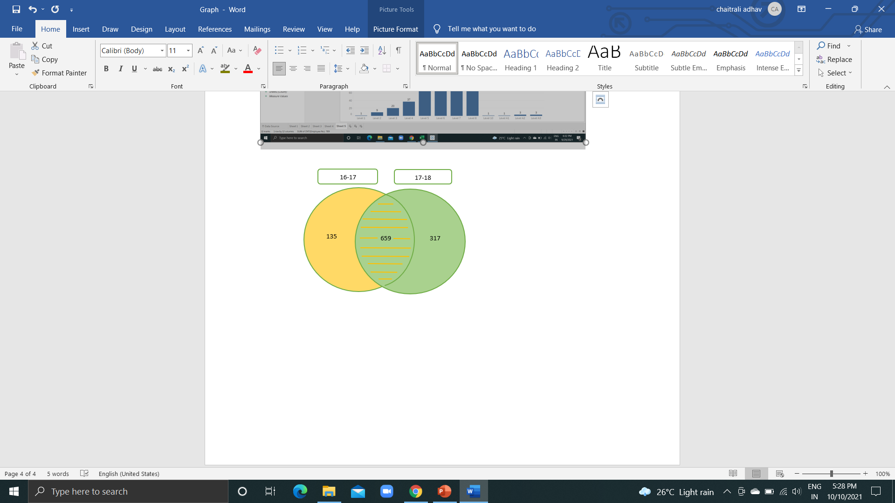
Data Preparation and Feature Engineering
Data Preparation and Feature Engineering
Description:
The combined file has 22 columns and 1111 rows.
96 columns(monthly data of Total Hours, Total Available Hours, Work Hours, Leave Hours, Training Hours, NC Hours, Utilization% ) from each excel sheet were removed as a part of data reduction because they are only important while building time series model.
New attributes were added to the combine excel sheet like tenure , employee present in both fiscal and promotion .
Tenure was calculated for the employees using the joining date column which is provided in the data and termination date for resigned employees.
For active employees it is calculated from joining date till March 2018.
Promotion was calculated by comparing employee position for both the years.
Employees who were present in both the years and individually present in 2016-17 & 2017-18 also are represented by- 0-employees who were present in both year,1 - present in 2016-17 and 2 – present in 2017-18.
Current status column has active , resigned, secondment, sabbatical and new joiner as unique values, this was converted to binary column by considering secondment , sabbatical and new joiner as active employee.

Slide 11
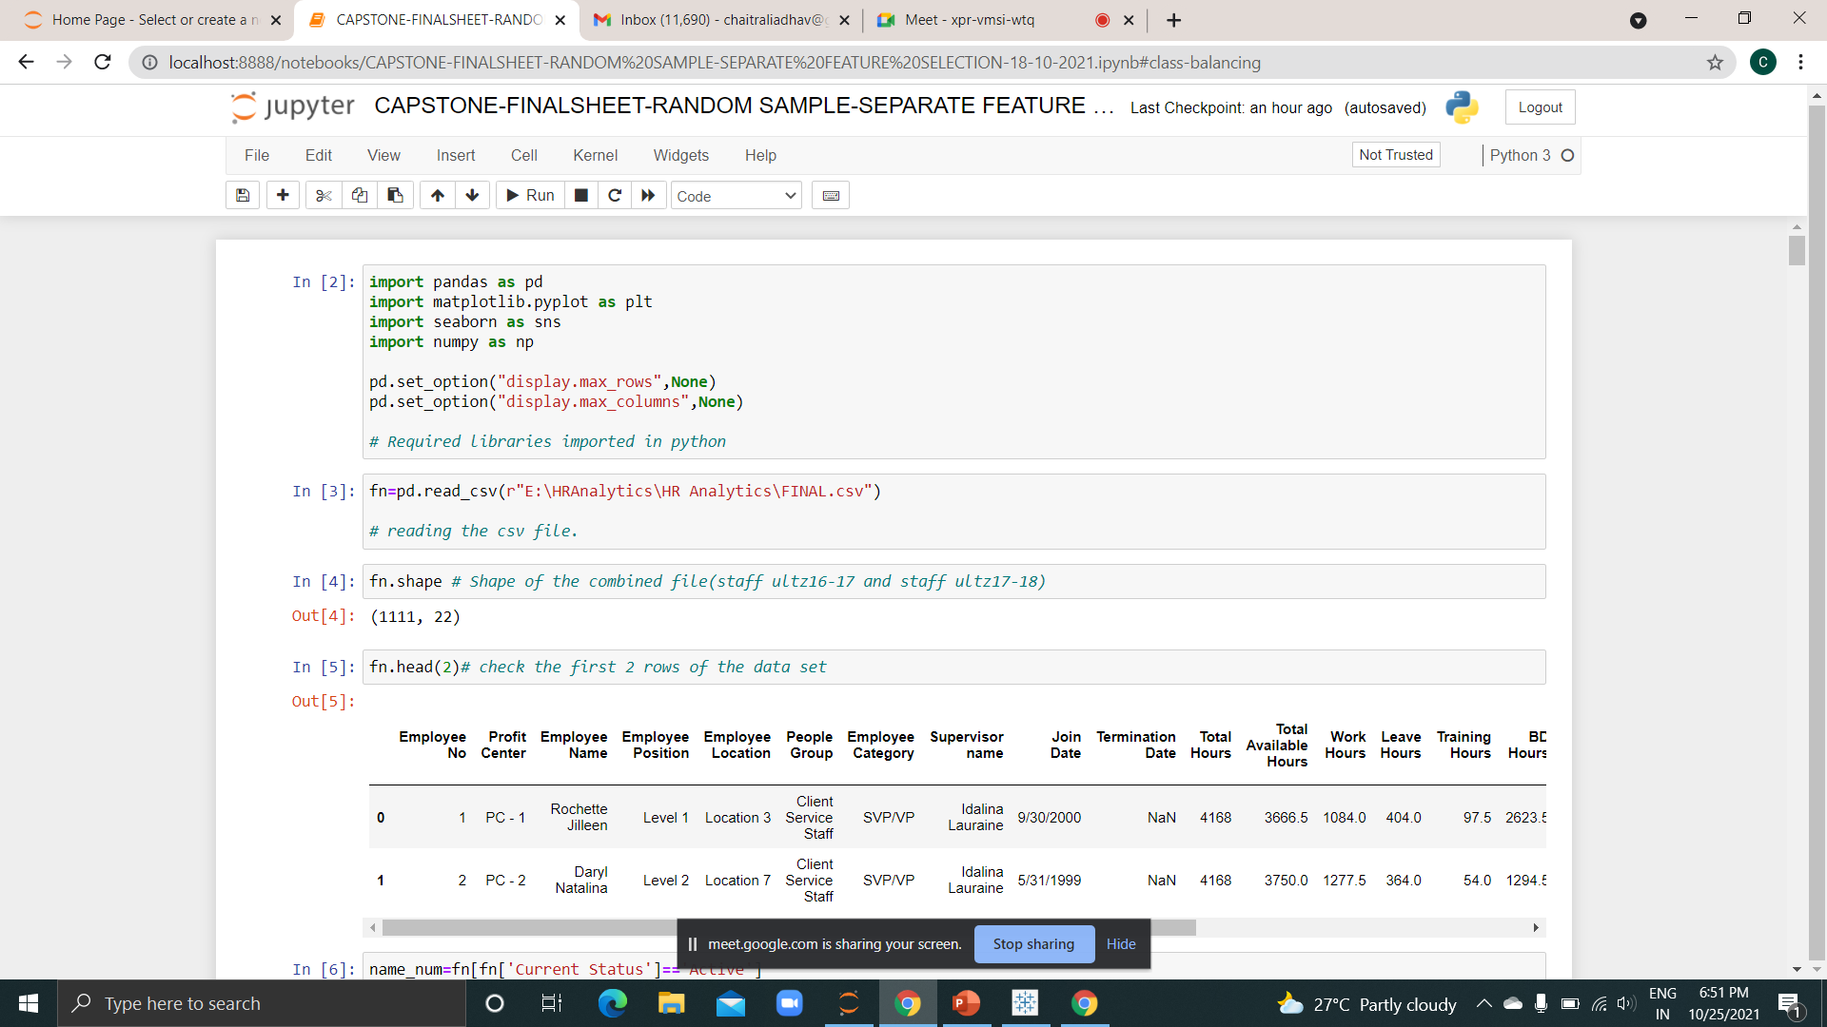
Data cleaning
Data Cleaning
Data cleaning in python:

Slide 12
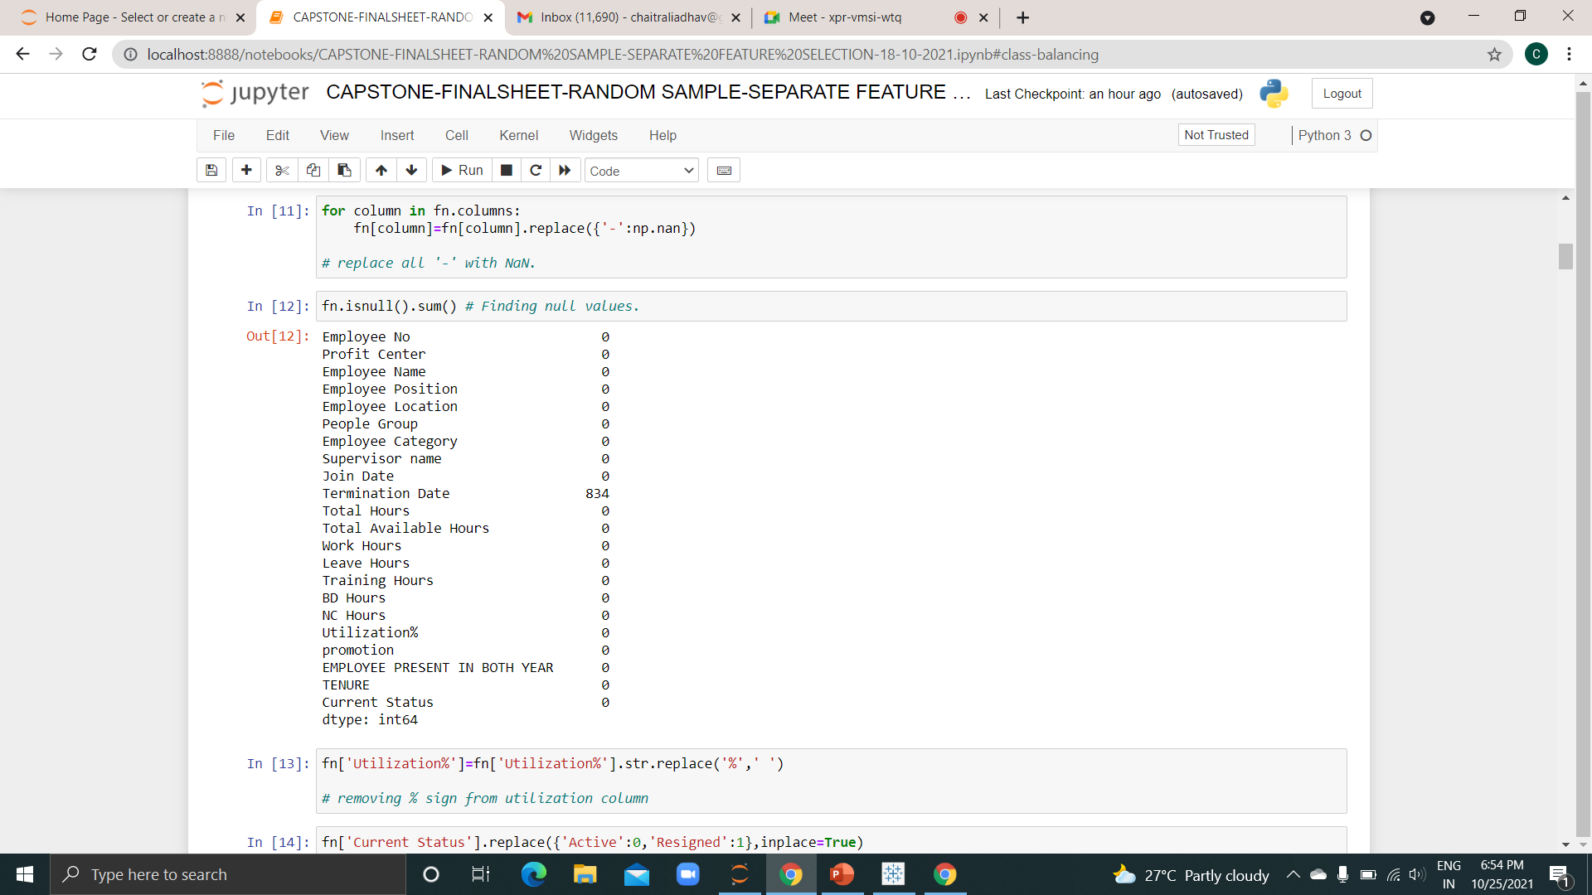
Data cleaning
Data Cleaning
Removing null values: Termination Date column has 834 null values, which is more than 50%,hence provides no information for supervised learning.

Slide 13
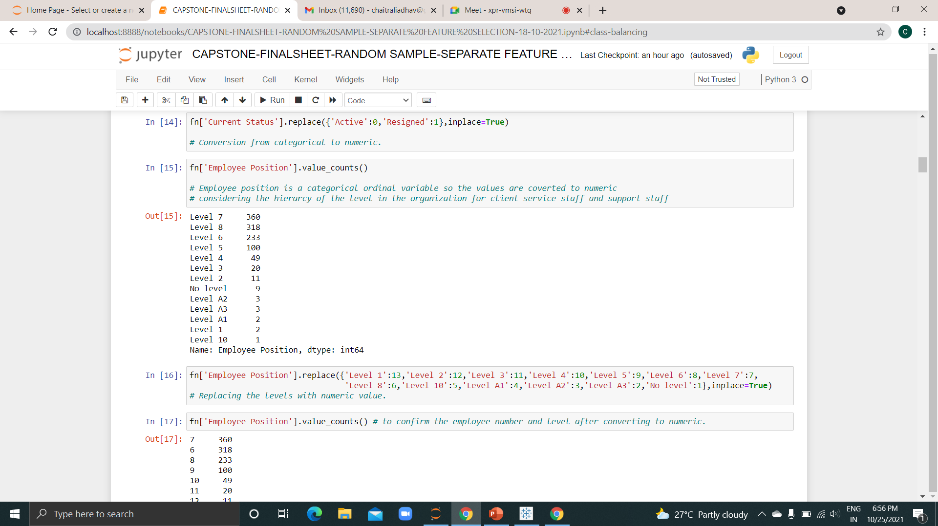
Data cleaning
Data Cleaning
Conversion to numerical data type: Current status and employee position were converted separately using replace function, remaining using label encoder.

Slide 14
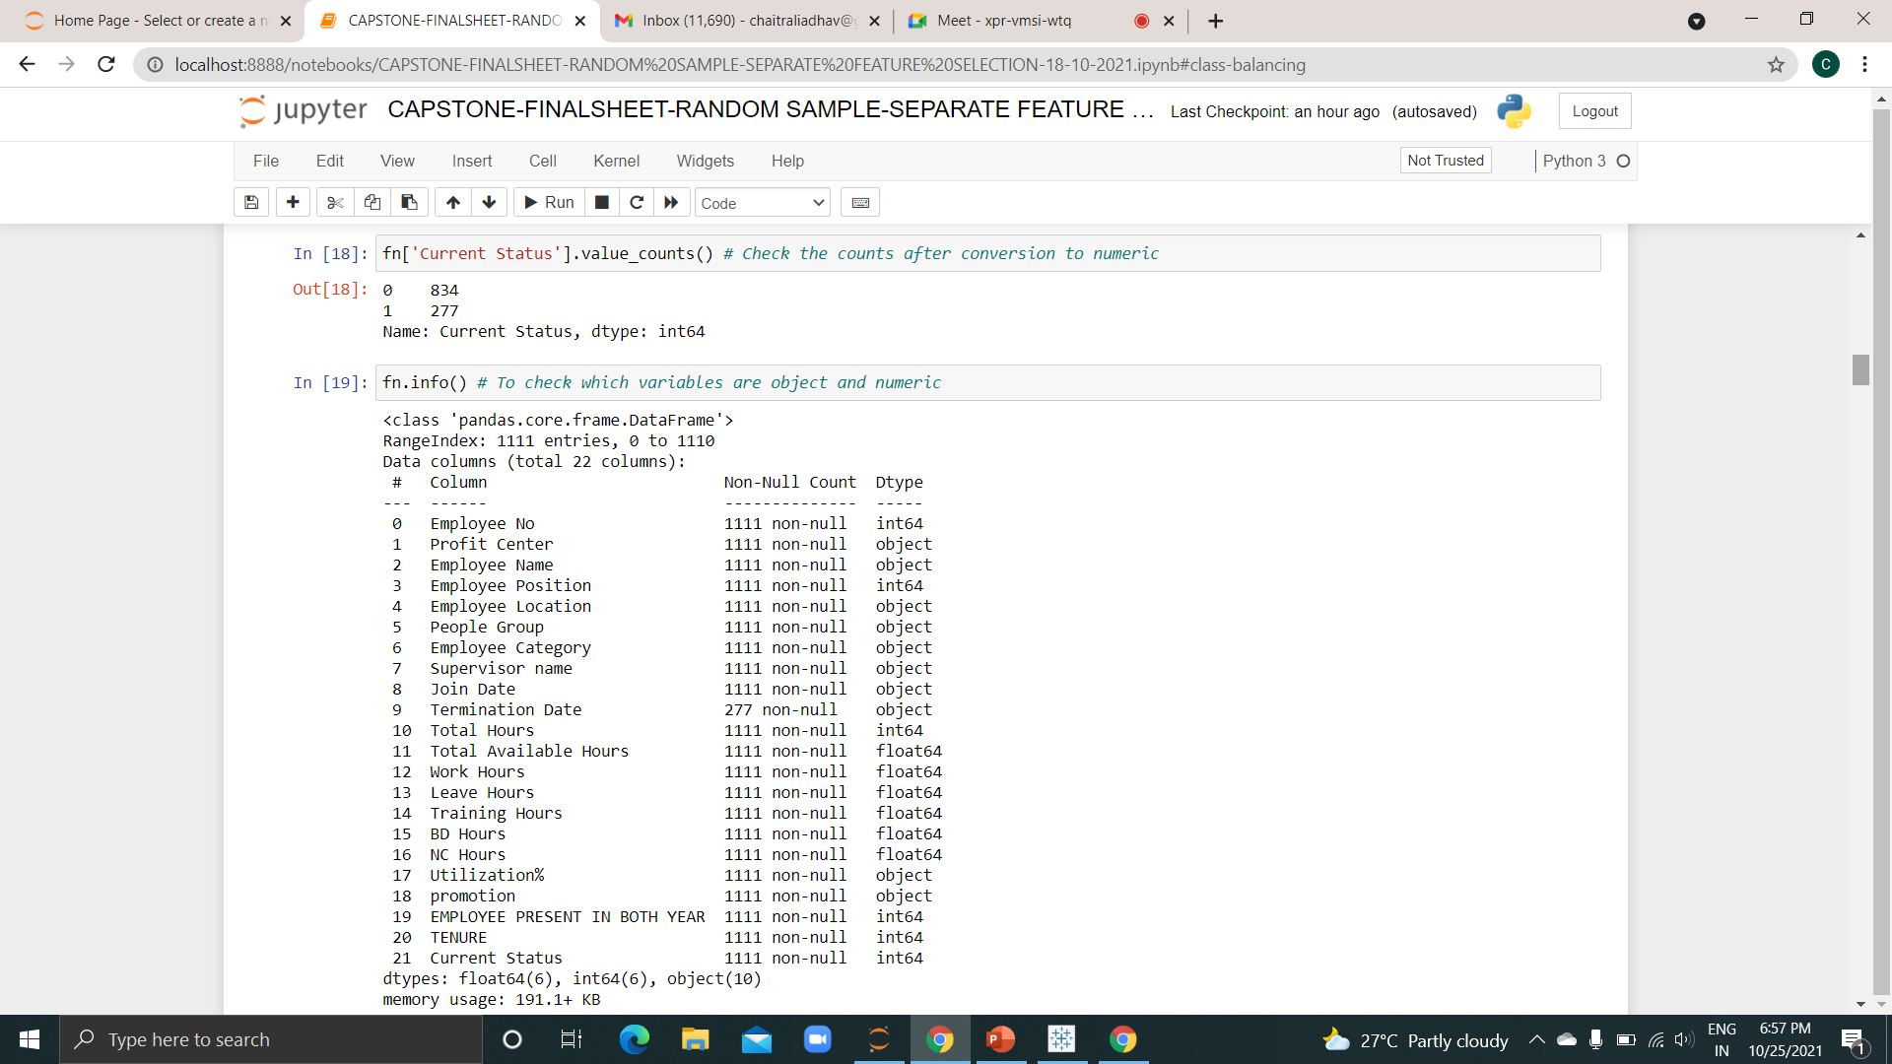
Data cleaning
Data Cleaning
To find the remaining object variables which needs to be converted to numerical data type.

Slide 15
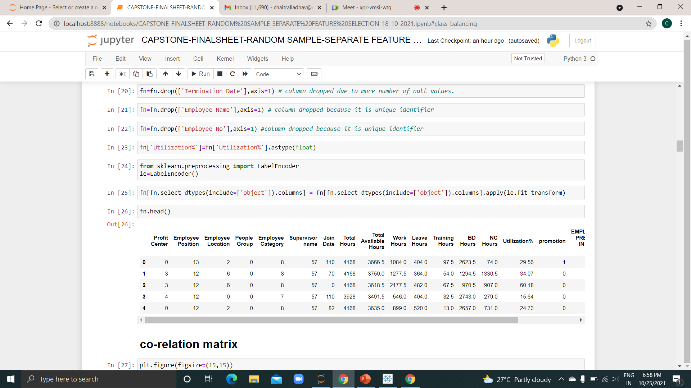
Data cleaning
Data Cleaning
Dropping of the columns which are unique identifier and having high null values.
Converting remaining object columns to numeric using label encoder.

Slide 16
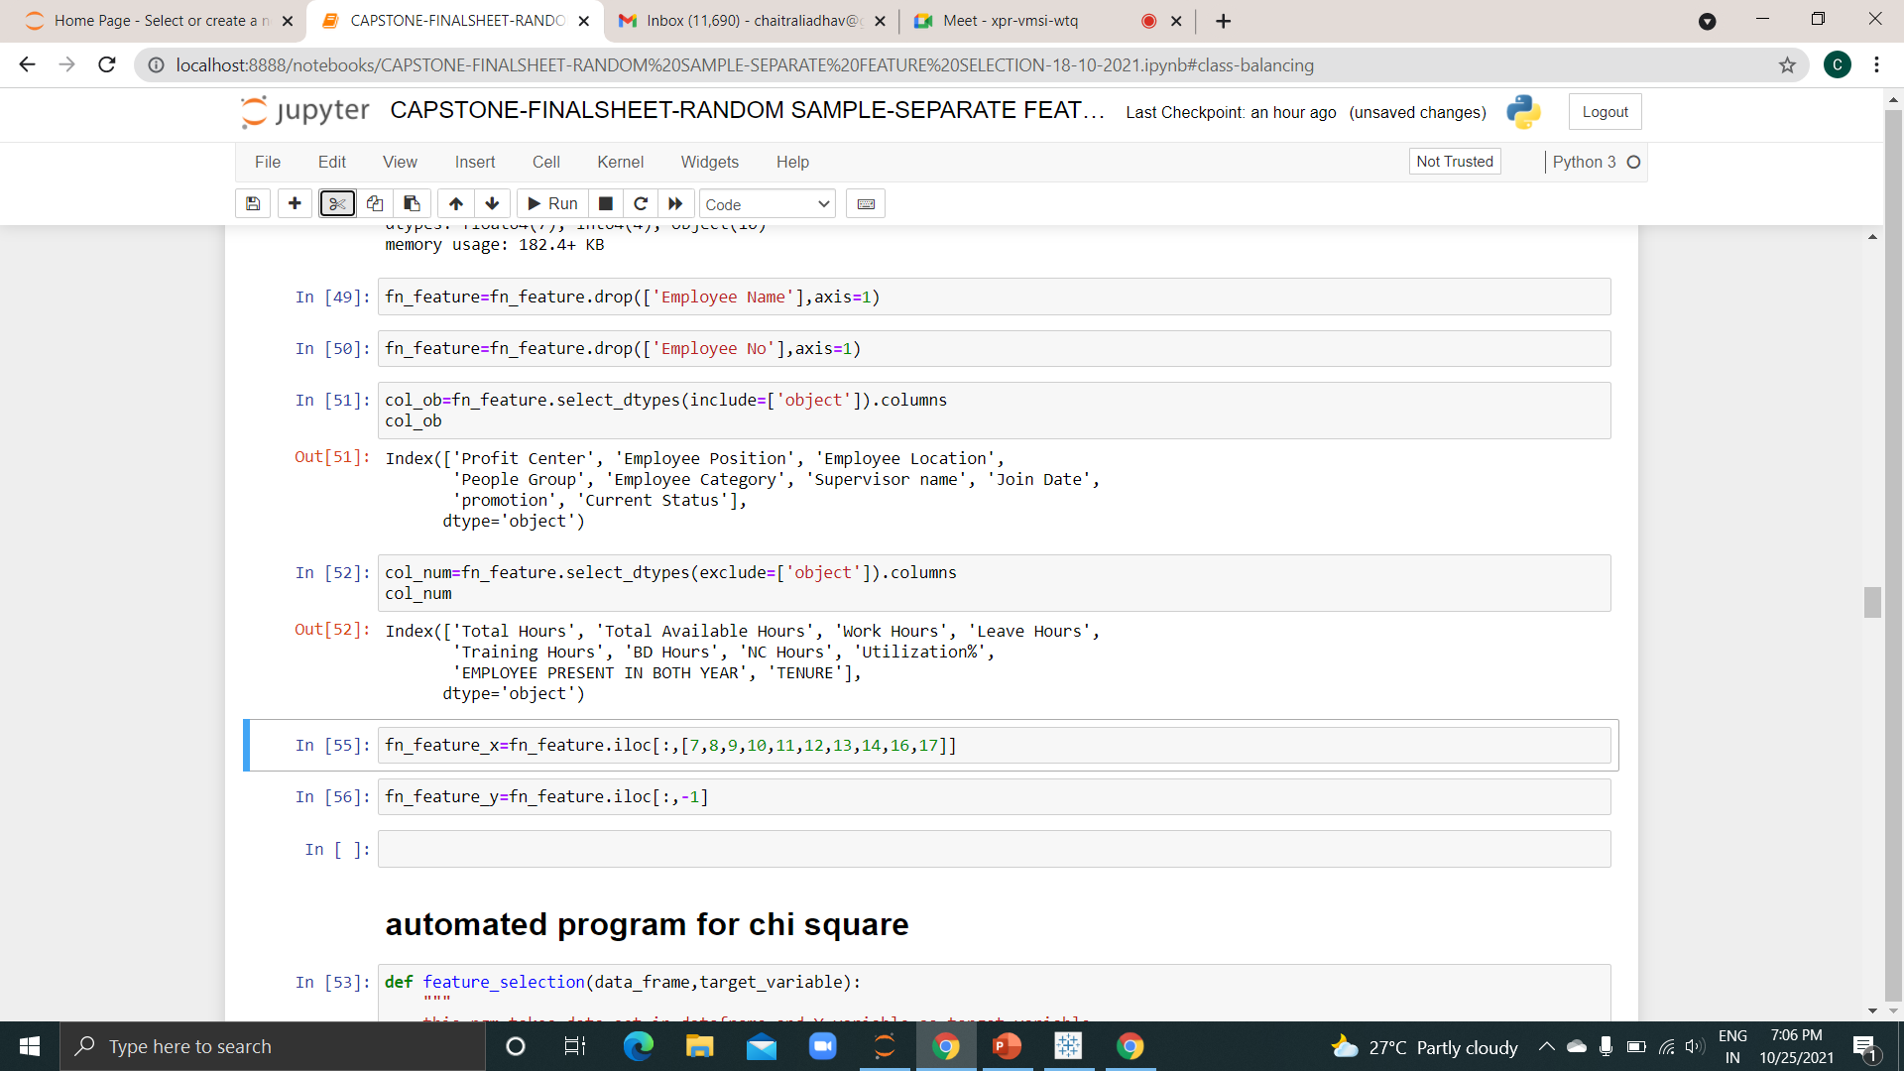
Feature Selection
Data Cleaning
Line 51 shows all the categorical columns and line 53 shows all numeric columns.
Feature selection for categorical and numerical columns were done separately using chi2 and RFE respectively.
Automated functions for chi2 test and RFE was used.

Slide 17
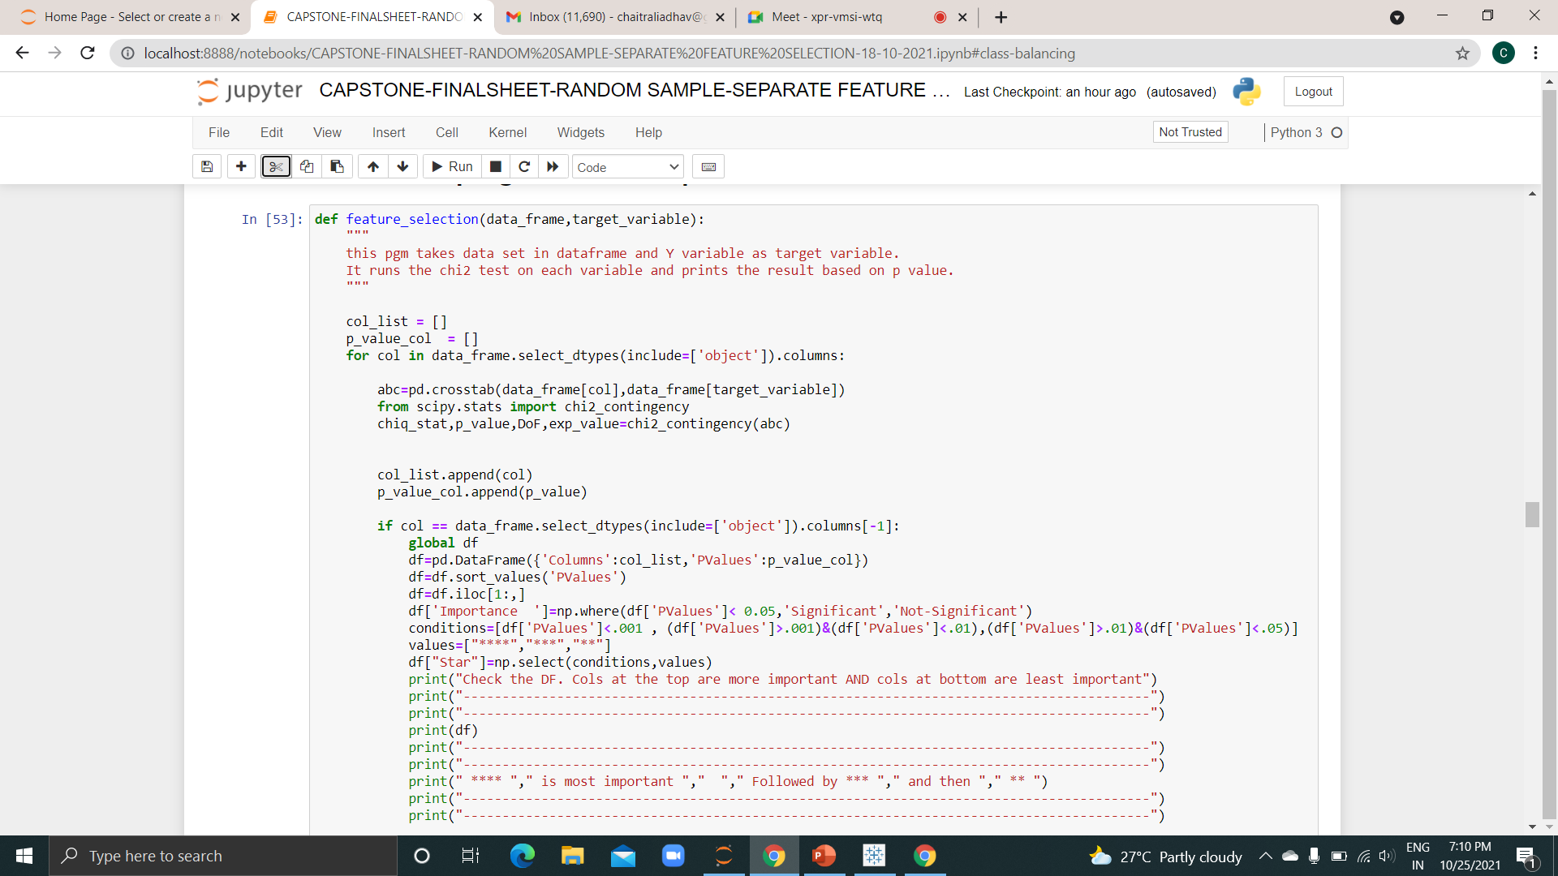
Feature Selection
Feature Selection
Chi-square test: This is the automated function for chi2 test . The test is applied only on categorical variables, it displays result in terms of column significance and p values.

Slide 18
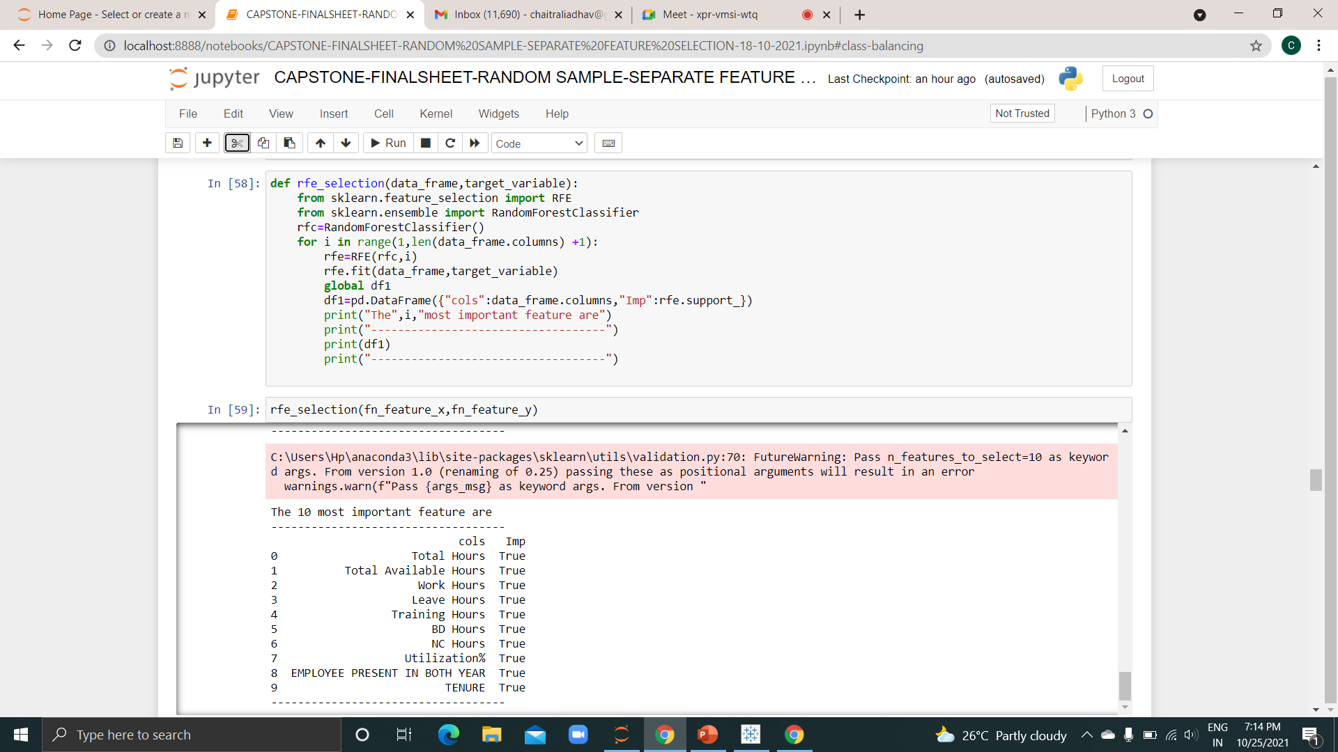
Feature Selection
Feature Selection
Recursive Feature Elimination (Automated Function) : This function is applied only on numerical variables, it displays result in terms of column importance.

Slide 19
Feature Selection
Feature Selection
Below is the list for selected feature for categorical and numerical columns.
Columns | Pvalues | Importance | Star
Employee Category | 6.68E-200 | Significant | ****
Join Date | 4.87E-35 | Significant | ****
Profit Center | 1.77E-28 | Significant | ****
promotion | 2.68E-13 | Significant | ****
Supervisor name | 2.07E-11 | Significant | ****
Employee Position | 7.31E-03 | Significant | ***
Employee Location | 1.75E-01 | Not-Significant | 0
People Group | 4.66E-01 | Not-Significant | 0
Categorical column
Columns | Importance
Total available hours | TRUE
Training hours | TRUE
Tenure | TRUE
Total hours | TRUE
employee present in both years | TRUE
work hours | TRUE
leave hours | TRUE
NC hours | TRUE
Utilization% | TRUE
BD hours | TRUE
Numeric columns-columns arranged from high importance to less importance

Slide 20
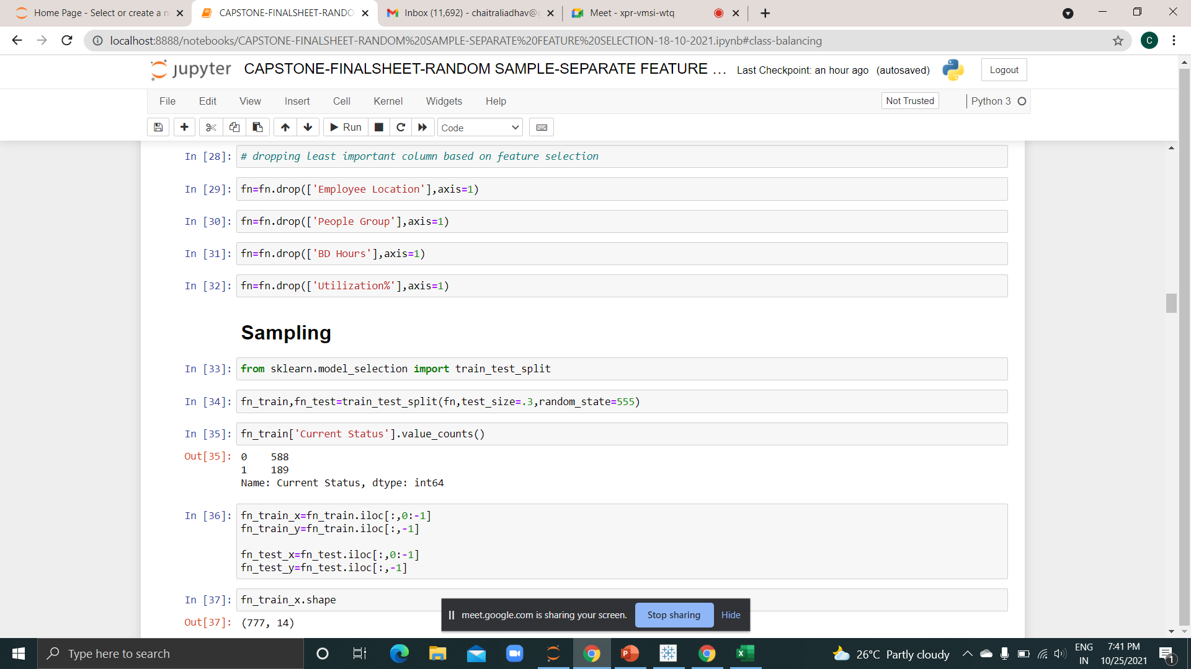
Sampling
Sampling
Columns dropped based on feature selection
Data was split in train(0.7) and test(0.3), and then further split in x and y. Shape of train data -777 and test is 334.

Slide 21
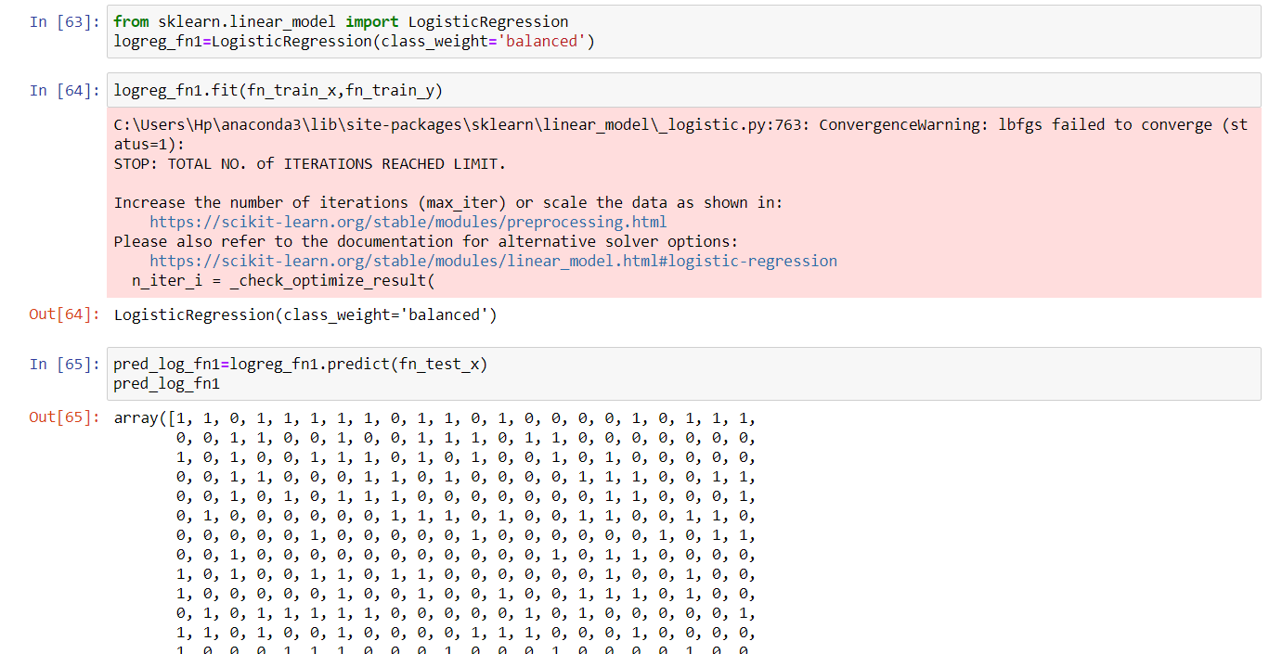
Model Building-Logistic Regression
Model building
Model – Logistic Regression

Slide 22
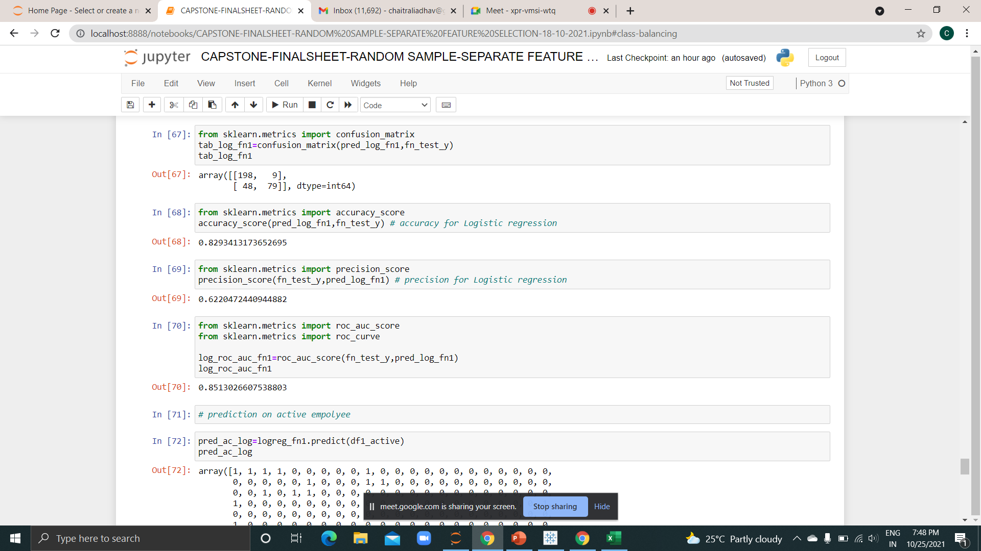
Model Evaluation-Logistic Regression
Model Evaluation
Model evaluation parameters for logistic regression.

Slide 23
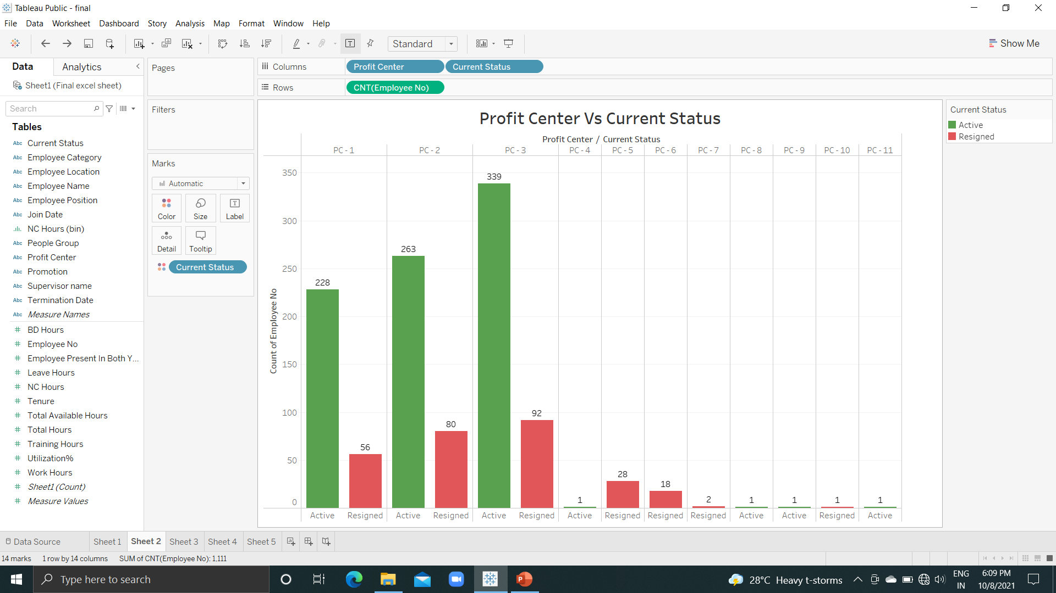
Exploratory Data Analysis(visualization)
Exploratory Data Analysis(visualization)
The graph shows number of employees active and resigned in each profit center.
Profit centers 1,2, and 3 have comparatively more resigned employee than rest.
Profit centers 5,6,7 and 10 has no active employees.
Centers 4,8,9 and 11 has only active employees.

Slide 24
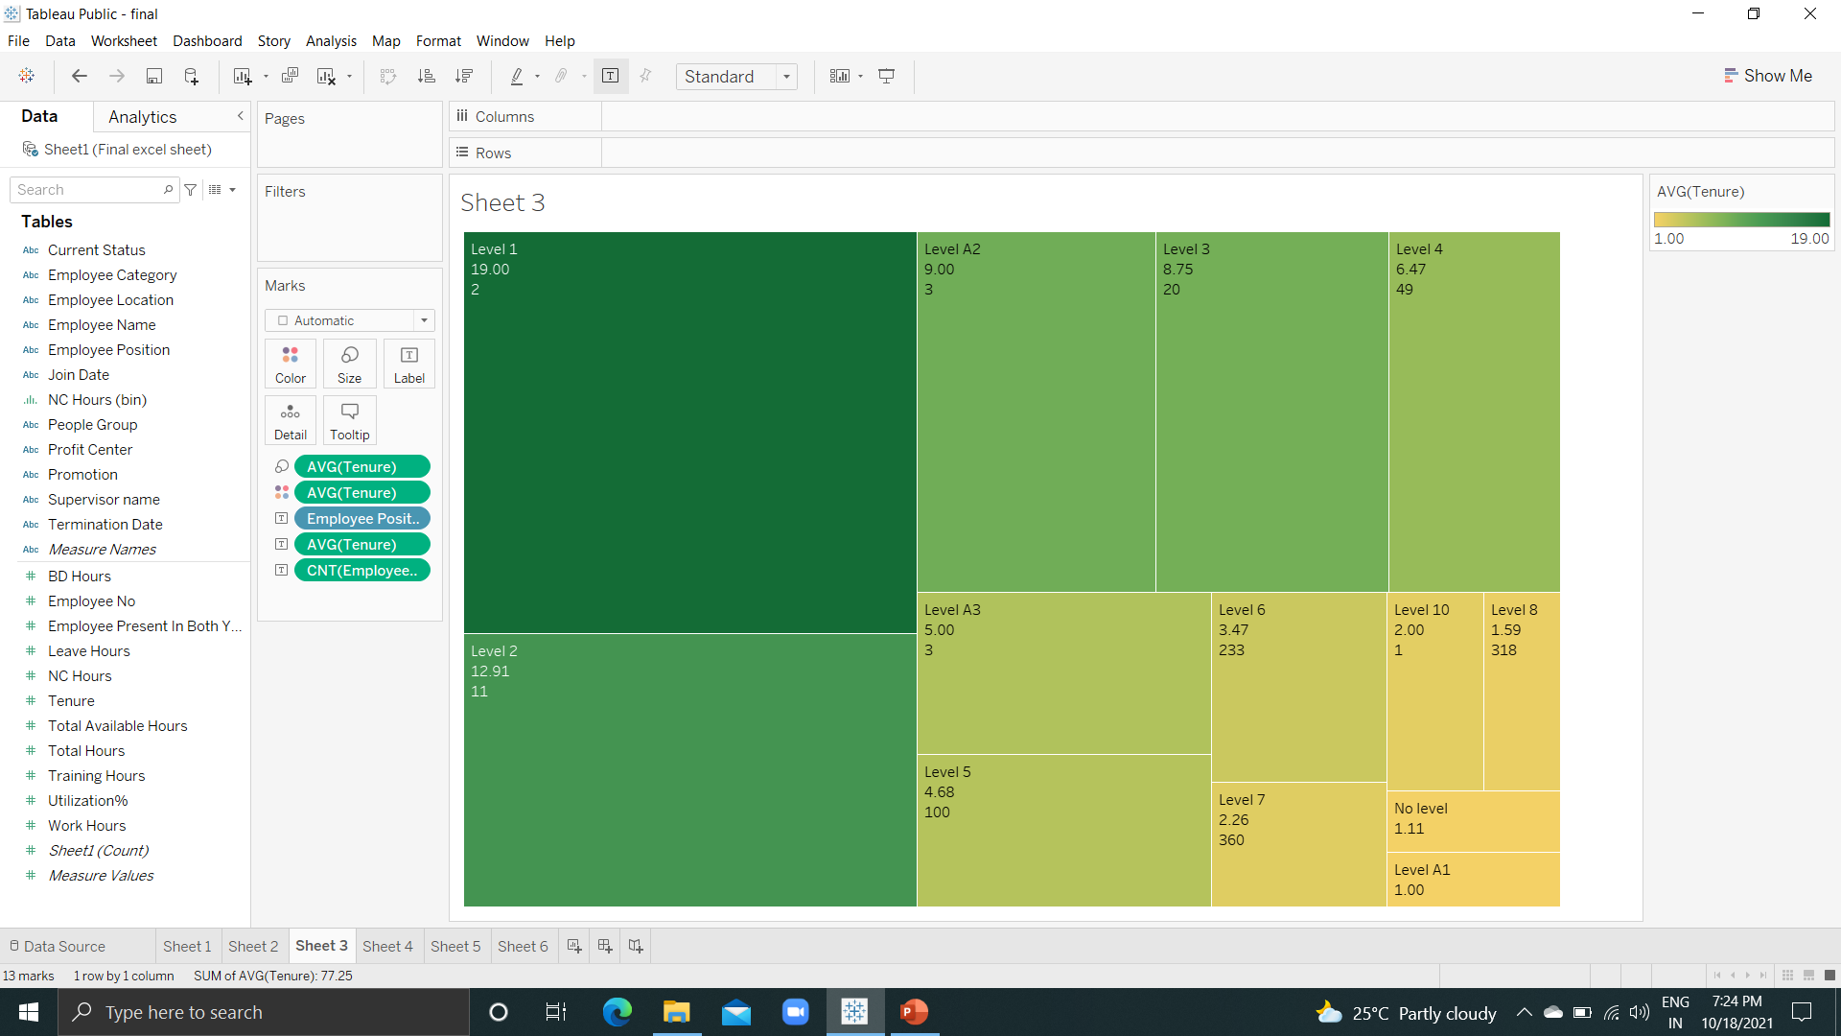
Exploratory Data Analysis(visualization)
Exploratory Data Analysis(visualization)
Graph represents employee position level , tenure and number of employees.
Employee position levels 6,7,8 has maximum number of employees 233,360,318 respectively.
Levels 1-10(level 9 is missing in data) are for the client service staff, remaining levels A1,A2,A3 are for support staff.
Level 1 has an average tenure of 19 years which is the highest and level A1 has an average tenure of 1 year which is lowest.

Slide 25
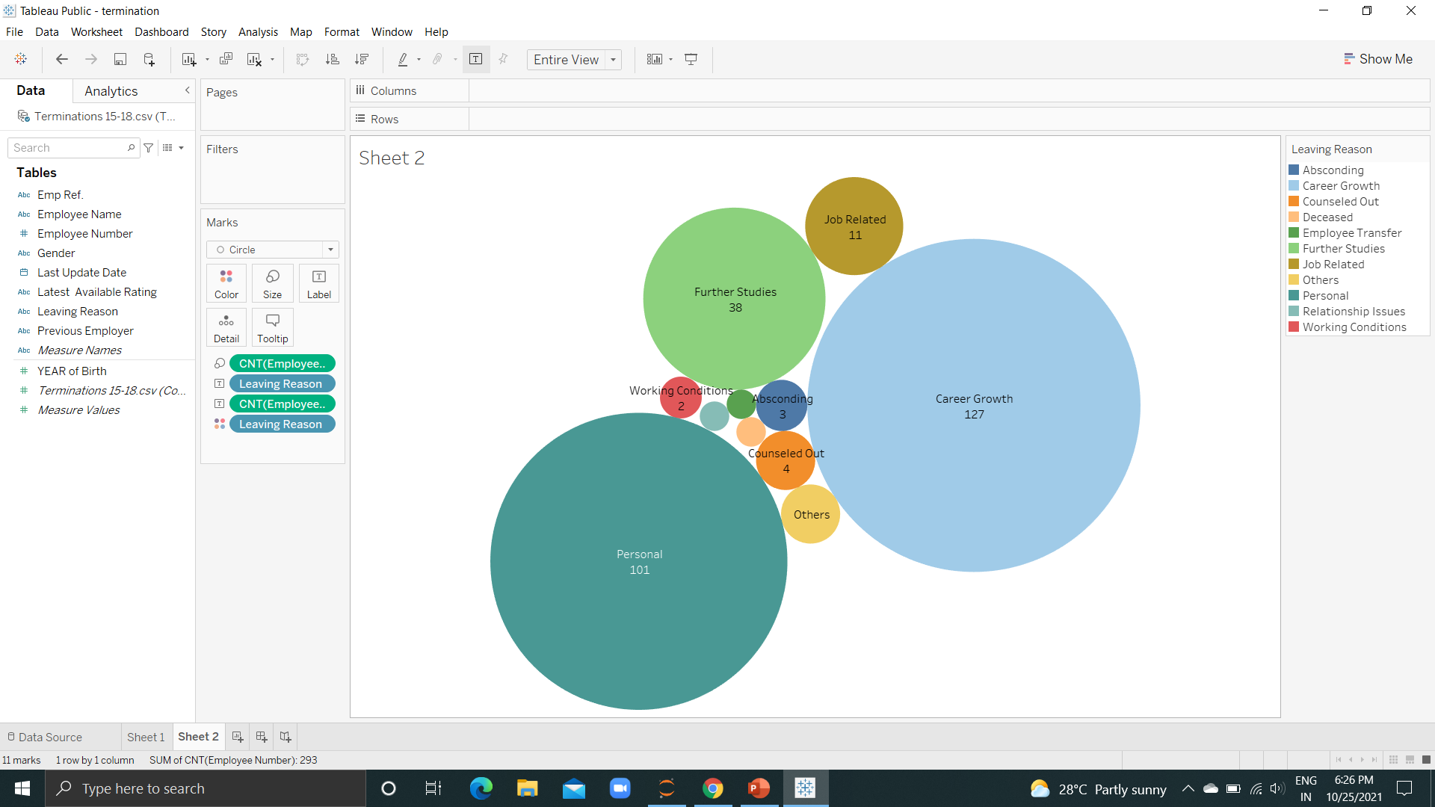
Exploratory Data Analysis(visualization)
Exploratory Data Analysis(visualization)
Major leaving reasons among the employees are career growth , personal reason and further studies.
100 male and 27 female employees left for career growth.
53 males and 48 females for personal reasons.
26 males and 12 female employees left for further studies.

Slide 26
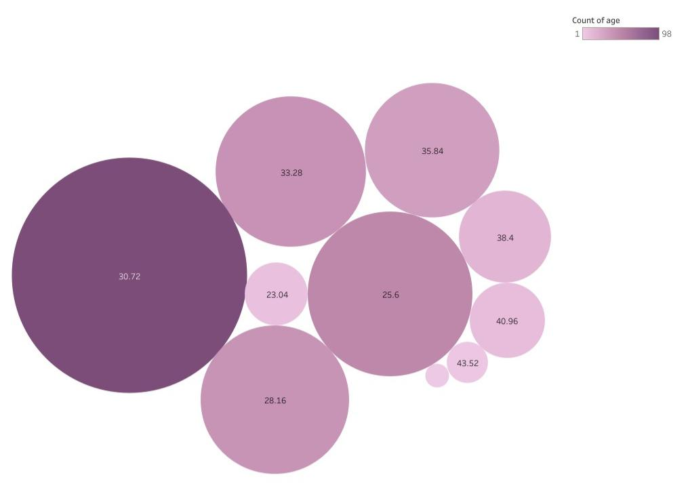
Exploratory Data Analysis(visualization)
Exploratory Data Analysis(visualization)
Majority employee aged 31 have resigned.
Followed by 26 and 28 years of age.
There’s low chance of a employee Leaving after age of 43.

Slide 27

Objective 1-Results and Conclusion
Factors influencing attrition :
Employee Category
Work hours
Profit Centre
Promotion
Supervisor name
Employee position
Total Available hours
Training hours
Tenure
Employee present in both years
Leave hours
NC hours

Slide 28
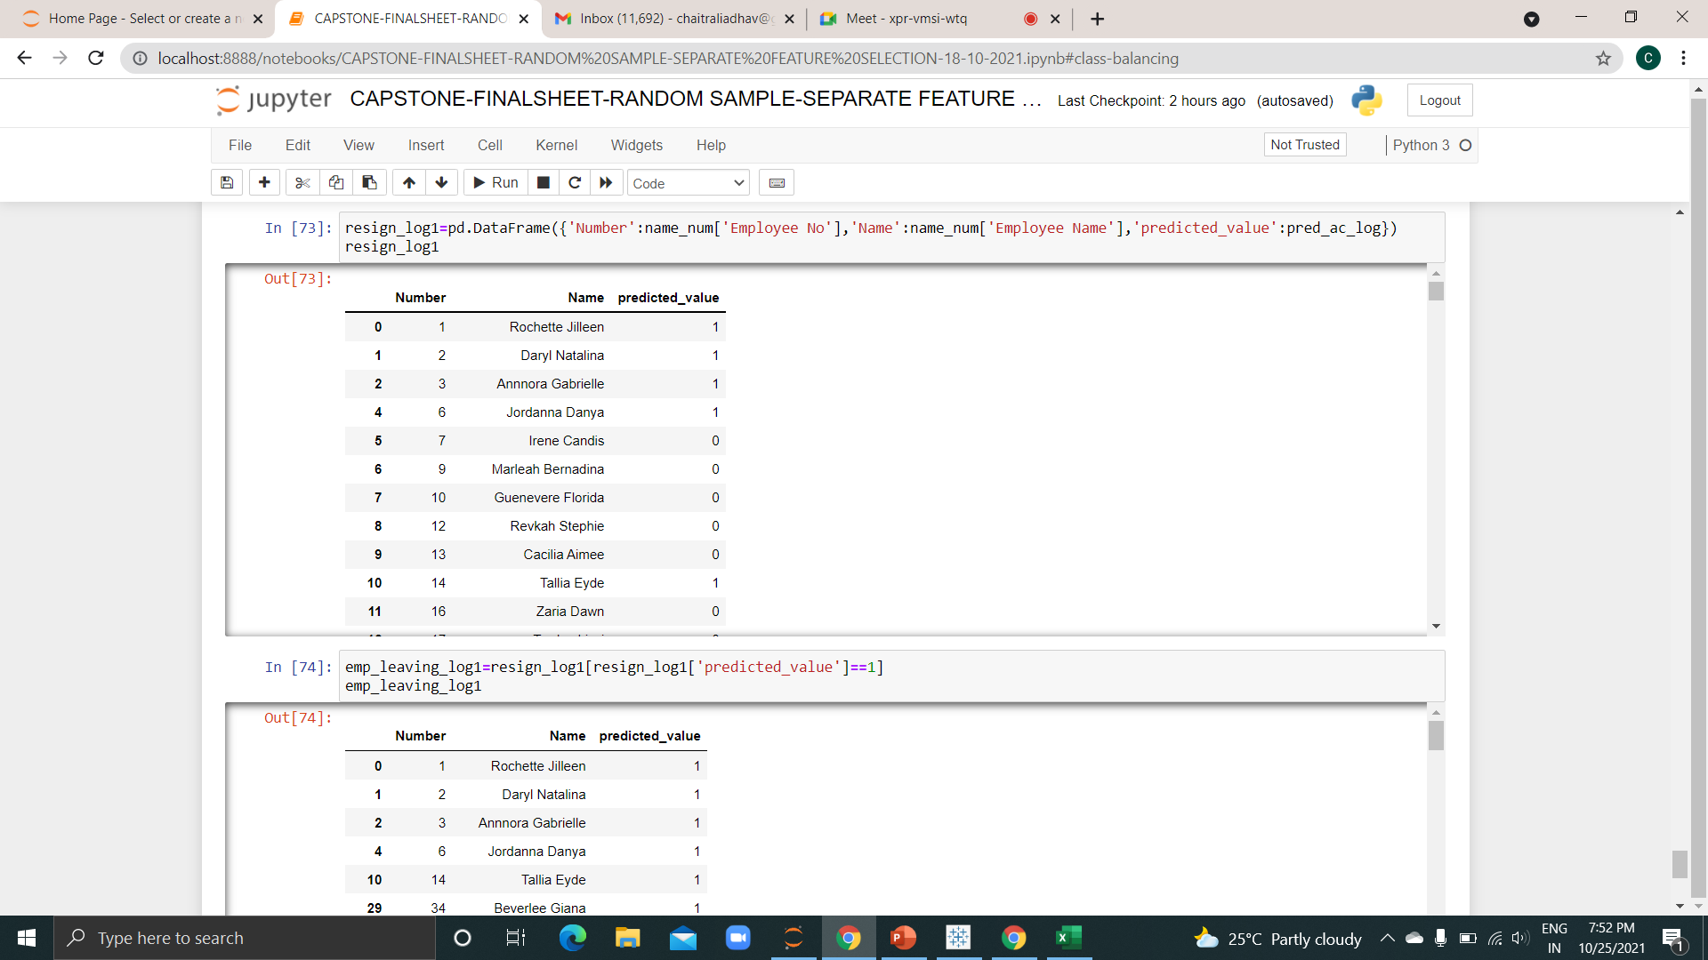
Objective 2- Results and Conclusion
Model Evaluation
Predict Possible attritions:
First objective is to predict the employee who are likely to leave the organization.
147 employees out of 834 are predicted to leave the organization.

Slide 29
Objective 2- Results and Conclusion (Cont.)
Names and employee number who are predicted to leave the organization.
As per our model prediction, top management employees are going to resign from the organization

Slide 30


Objective 3-Results and Conclusion
Possible ways to retain high performers :
High performers but leaving- Rochette Jilleen & Carolynn Alicia
The top performers should be given monetary, non monetary incentives, rewards and recognitions.
The supervisors of these employees should be given retention training and empathy training

Slide 31


Objective 3-Results and Conclusion (Cont.)
From termination data, 38 employees left the organization for their higher studies. To prevent this organization can collaborate with esteemed institution so that the employee who are willing to pursue higher education can be retained.
Work hours of employees having lower utilization should be increased.
.

Slide 32


